Slide 1
Introduction to Forensic Sciences

Slide 2
Forensic Sciences?
Forensic (?) + Sciences (?)
Forensic sciences- an amalgamation of all sciences- used for judicial purposes.
The application of the methods, principles and techniques of the natural and physical sciences to matter of criminal and civil law (purpose of justice)
Identify, analyze, and compare the materials.
Establish the link b/w the crime, the criminal, the victim, the weapon of offence, the place and the time of occurrences.
It may be a simple identification of presences of a criminal to the complicated profiling. (from obvious evidences to complex DNA, molecular biology etc.,)
Multi-disciplinary field composed of many divisions and its units or subdivisions.

Slide 3
Introduction:
Forensic (Latin) – of // before the forum
The term originated from the Roman times- where the criminal charges are meant to be presented before a group of public individuals in the forum.
Both parties presented their cases and the judgement-based on the best of their arguments.
1835- Henry Goddard- Used physical matching to connect the bullet with the murder weapon.
1836- James March- developed a chemical test to identify arsenic poisoning
1853- Mathieu Orfilia- detection of poisons// their effect on animals
1892- Chinese started fingerprints to ensure the business documents
1896- Sir Edward Henry- Henry’s classification
1910- Edmond Locard- Father of FS// First police crime laboratory- France
1930- Karl Landsteiner- blood grouping

Slide 4
Nature and Scope of Forensic Sciences
Nature: application of a broad spectrum of sciences to answer questions of interest to a legal system. This may be in matters relating to criminal law, civil law and regulatory laws. it may also relate to non-litigious matters.
Scope is everywhere where there arises a question of interest to a legal system.

Slide 5
2 Important Terms in Forensics
Corpus Delicti
Modus Operandi

Slide 6
Forensic Sciences – The Concept:
Based on Locard’s Principle of Exchange
Whenever two objects- animate or inanimate,, microscopic or macroscopic, in whichever physical state- comes in contact with each other, there would be an exchange of materials and/or matters. (These materials and matters are known as Evidence)
3 types of evidence:
Testimonial evidence
Physical evidence
Trace evidence
Cyber Evidences
Forensic sciences essentially deal with the laboratory examination of different types of evidence encountered at the crime scene.
Physical evidence is preferred over human evidence.

Slide 7
Principles of forensic sciences
7 basic principles of Forensic Sciences
Law of Individuality
Principle of Exchange
Law of Progressive change (Everything changes with the passage of time)
Law of Comparison (only likes can be compared)
Law of Analysis (Analysis can be no better than the sample analyzed)
Law of Probability
Law of Circumstantial Facts (Facts do not lie, human can and do)

Slide 8
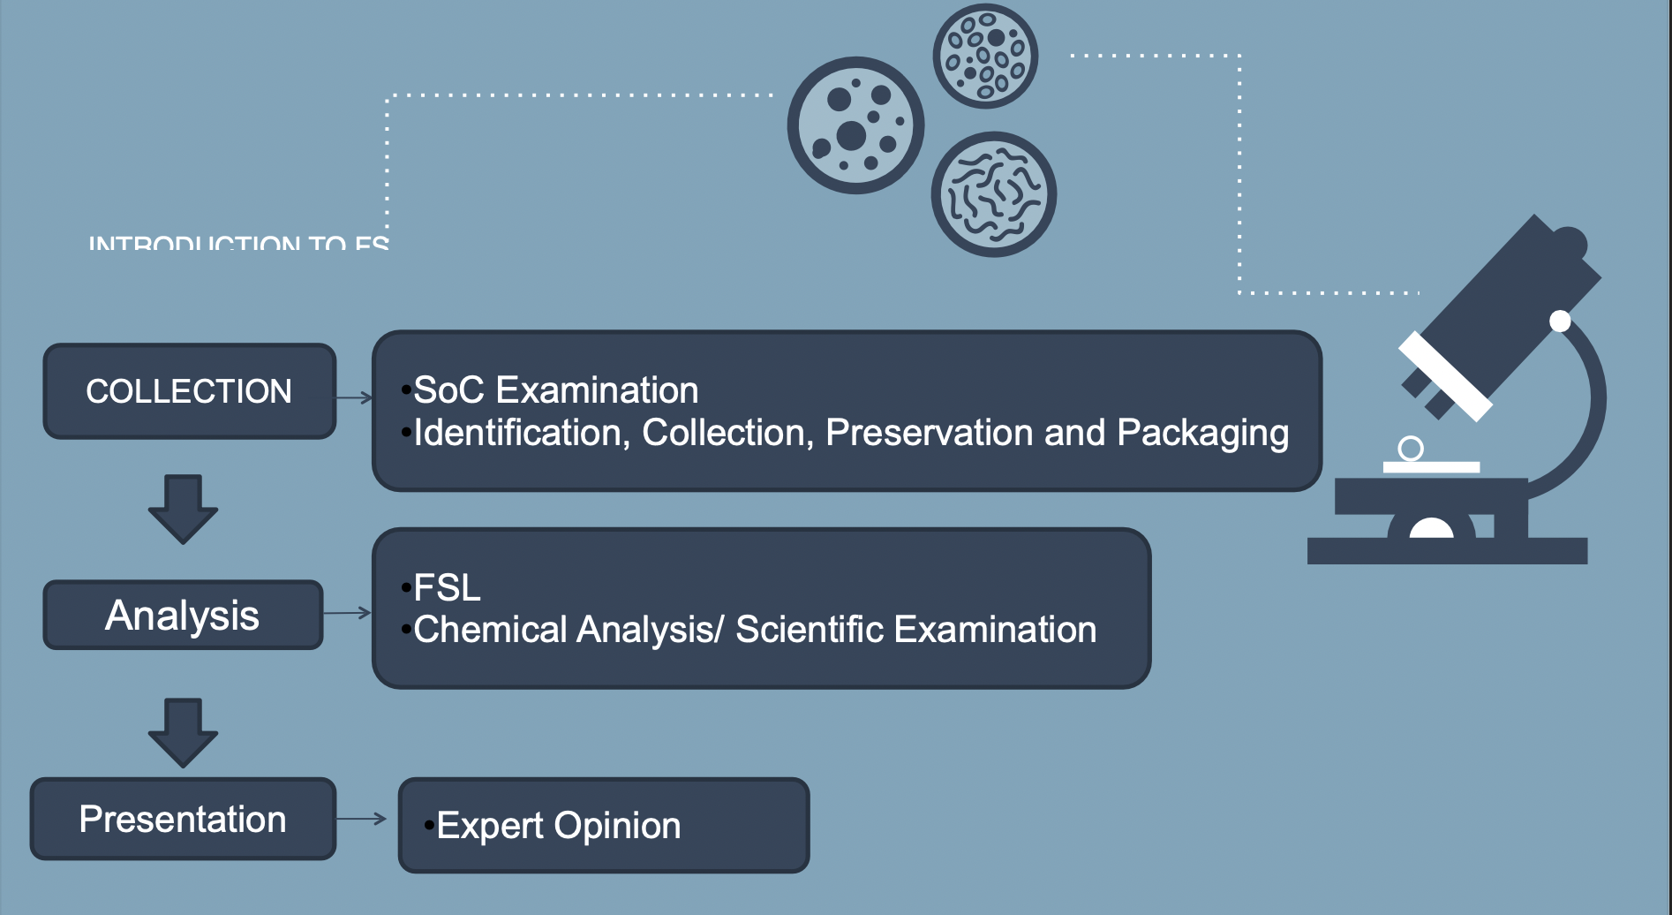
Forensic Scientist

Slide 9
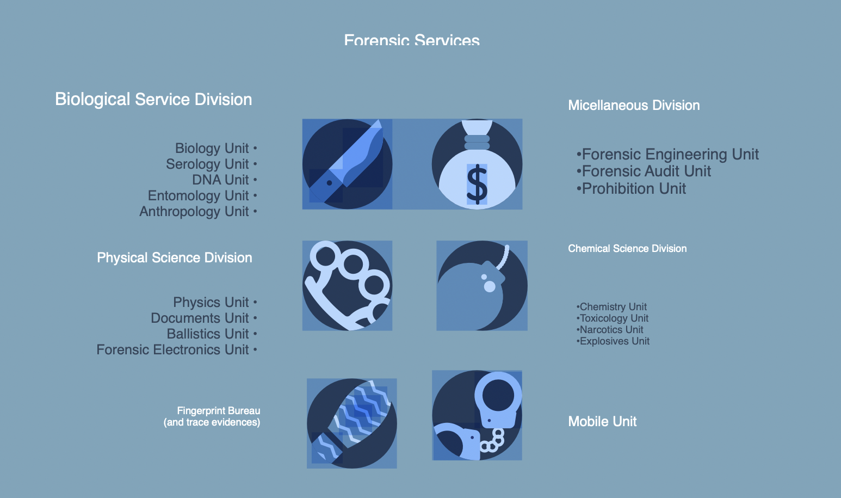

Slide 10
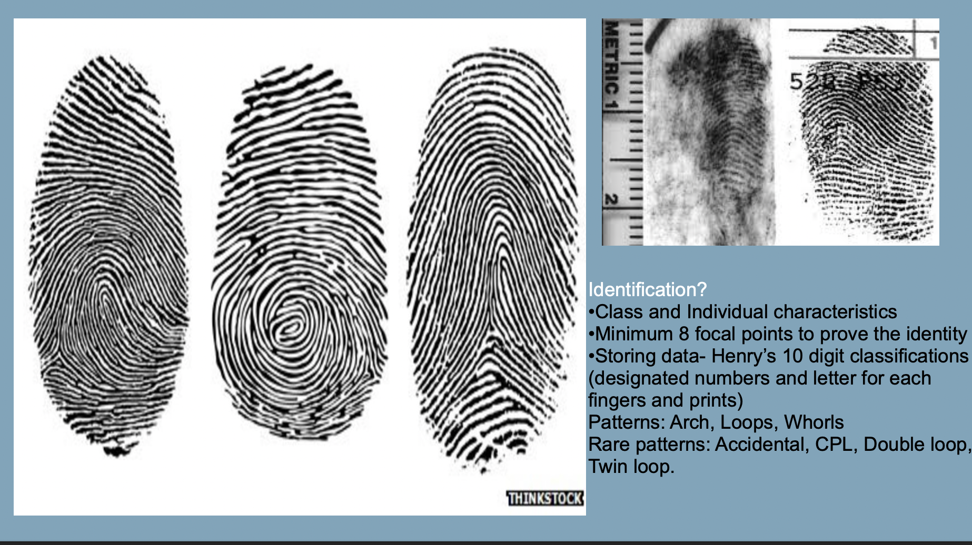

Slide 11
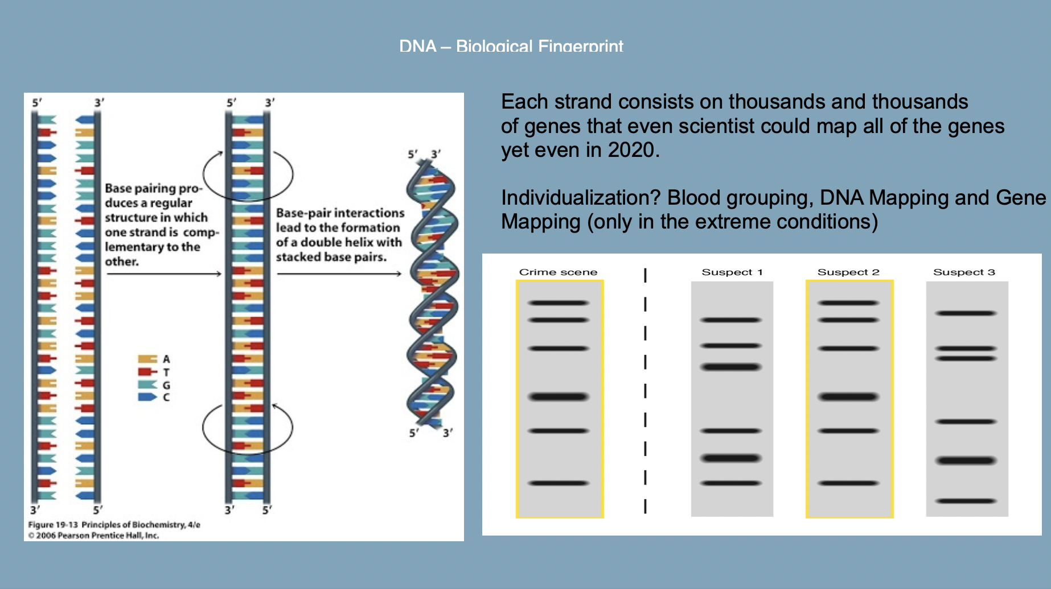

Slide 12
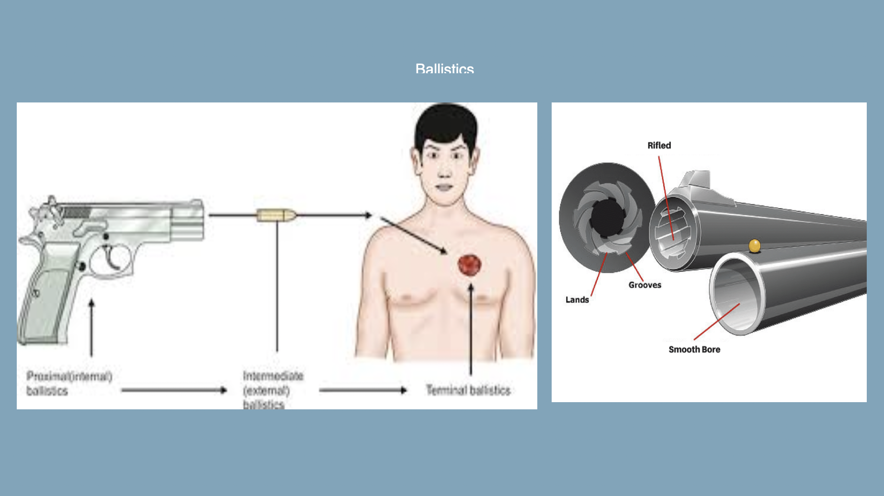

Slide 13
